Slide 1
ACT-RK (ACT-R with improved Knowledge capabilities)
Alessandro Oltramari*
(joint work with Christian Lebiere*, Jerry Vinokurov*, Scott Fahlman**)
*FMS group, Department of Psychology, Carnegie Mellon University
**Language Technologies Institute and Computer Science Department, Carnegie Mellon University
Notes:
“pronounced as ACT-ARK”

Slide 2
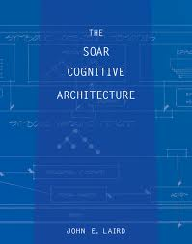
“Representations of knowledge without an architecture are like programs without a computer – they do nothing.”
“An architecture without content is like a computer without software – it is an empty shell”
“It is the combination of knowledge and the architecture that leads to purposeful behavior”…and full-fledged cognitive systems
_______________________________________
Laird, J.E.: The SOAR Cognitive Architecture. The MIT Press (2012)

Slide 3
Outline
Motivations
Architecture
Enabling Visual Intelligence with ACT-RK
Notes:
2) Why we need it ? what is it? How does it work?

Slide 4
Motivations

Slide 5
The “Unified Stance”
“Cognitive systems benefit from both the mechanism-centered (1) and knowledge-centered (2) approaches to computationally achieve human-level intelligence”.
In particular,
Problem-solvers and architectures are task-specific
Knowledge-base systems for representation and reasoning are task-independent
Notes:
I call this position, Unified Stance (inspired by Newell 1990 book) – Grand Unified Stance (= Paul Rosenbloom)

Slide 6
Artificial General Intelligence
The original goal of AI was the construction of computer systems with human-like general intelligence – Strong AI
Due to difficulty of the task, the majority of researchers have focused on a simpler goal, Narrow AI, the production of systems for highly constrained specific tasks.
In recent years more and more researchers have recognized the necessity – and feasibility – of returning to the original goals, confronting “human level intelligence” and more broadly artificial general intelligence (AGI).
Notes:
This framework shares the core motivations of research in AGI…
AGI conferences, 2010 (Lugano) – 2011 (Mountain View) – 2012 (Oxford)

Slide 7
Intelligence is Knowledge in Action
Integration is the key to intelligence
(1) and (2) strongly constrain each other, with learning mechanisms determining which knowledge can be acquired and in which form, and specific knowledge contents providing stringent requirements for mechanisms to be able to access them effectively
ACT-R encapsulates this integration through procedural and declarative knowledge
Notes:
Let’s see how

Slide 8
Is this enough to pursue AGI?
ACT-R needs to leverage knowledge-centric capabilities
DM contains only as much chunks as a task requires
Chunks have a coarse-grained semantics
Productions system is not optimal for inferential reasoning
ACT-R improved with Knowledge capabilities (ACT-RK)
contains a *dedicated module* for reasoning over highly structured semantic chunks (possibly using the inferred knowledge to feedback the other modules)
Notes:
DM is task driven ((low reusability)
Let’s see the features of this augmented ACT-R

Slide 9
Architecture

Slide 10
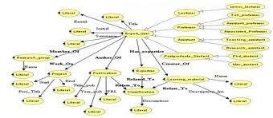
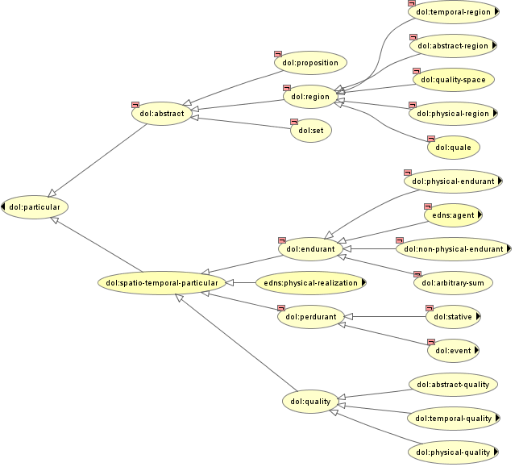
ACT-RK
Intentional Module
Episodic Module
Declarative Module
SCONE KB
Goal Buffer
ImaginalBuffer
Retrieval Buffer
Procedural Module
Vision Module
Scone
Module
Motor Module
Visual Buffer
Scone
Buffer
Manual Buffer
ACT-R
INPUT
OUTPUT
Environment

Slide 11
SCONE (1/2)
A LISP open-source KBS intended for use as a component in software applications
Represents symbolic common-sense knowledge through LISP defstruct, e.g.:
(new-type {walk} {action})
(new-type-role {participant} {action} {physical object})
(x-is-the-y-of-z {shovel} {participant} {bury})
A “Smart active memory system” plugged in ACT-R through additional module/buffer components, e.g.:
LHS
=goal>
ISA recognition
state output
=imaginal>
ISA output-features
observed =action
agent =core-actor
RHS
==>
=goal>
state reasoning
+scone>
ISA the-x-role-of-y
x {participant}
y =action
Notes:
* Like other KB systems – for example, Cyc and the various Description Logic systems
**See example
Defstruct (data)
Action: DIG

Slide 12
SCONE (2/2)
Unlike most KBS, SCONE engine adopts non-standard reasoning based on marker-passing algorithms
Originally conceived for parallel computing
Similar to spreading of activation in associative networks*
Fast (run-time) and simple but not logically complete
Inadequate for theorem-proving…
…but suitable for common-sense reasoning (highly expressive)
____________________
http://www.cs.cmu.edu/~sef/scone/
*Scott E. Fahlman: "Marker-Passing Inference in the Scone Knowledge-Base System”. First International Conference on Knowledge Science, Engineering and Management (KSEM'06), Guilin, China, August 2006. Proceedings published by Springer-Verlag (Lecture Notes in AI).

Slide 13
Example of SCONE reasoning
Query the KB to get all the parts of cars,
Assign a marker M1 to the A-node “car”
Search for all the statements in the KB where M1 is the A-wire (domain) of the relation PART-OF , returning all the classes in the range of the relation (also called `B-nodes'), e.g.
Finally assign the marker bit M2 to all B-nodes, and retrieve all the inherited subclasses

Slide 14
Enabling Visual Intelligence with ACT-RK

Slide 15
DARPA “Mind’s Eye”: synopsis
The “Mind's Eye” program seeks to develop in machines the capability for visual intelligence: the capability to learn generally applicable and generative representations of action between objects in a scene directly from visual inputs, and then reason over those learned representations.
A key distinction between this research and the state of the art in machine vision is that
the latter made progress in recognizing objects and their properties - what might be thought of as the nouns in the description of a scene
the focus of Mind's Eye is to add the perceptual and cognitive underpinnings for recognizing and reasoning about the verbs in those scenes, enabling a more complete narrative of action in the visual experience.
Notes:
This is the context of …

Slide 16
Example
Notes:
Might remind you of the movie “Memento”--- the problem of understanding behavior with short-term memory deficits.

Slide 17
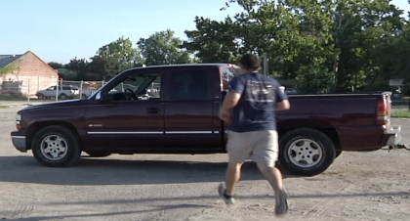
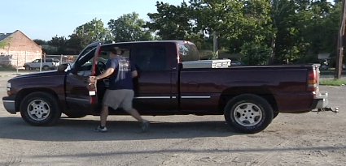
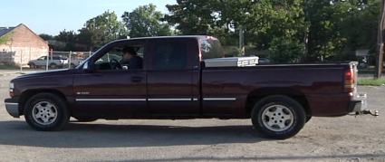
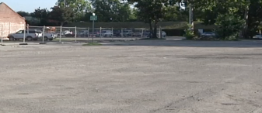
HOMINE + ACT-RK = The Cognitive Engine
Intentional Module
Episodic Module
Declarative Module
SCONE KB
Goal Buffer
ImaginalBuffer
Retrieval Buffer
ACT-R
Procedural Module
HOMINE
Vision Module
Scone
Module
Motor Module
Visual Buffer
Scone
Buffer
Manual Buffer
“A person enters in the car and drives off the scene to the left-side”
ENVIRONMENT
GT
3D
Pedestrian tracker
Pseudo GT
St features
Poses featured
3D features
SVM
Notes:
EAR architecture 2.0
VISION MODULE parses the quasi-propositional sequence produced by IAR
Red: I/O

Slide 18
What is HOMINE?
Terms have a semantics when the distinct features of the entities and facts they refer to are represented (= concepts), e.g.:
Cars are 4-wheeled vehicles
Seats are parts of cars
Cars are not persons
Every car needs exactly 1 driver
Drivers are persons (with some exceptions, especially in California, around Mountain View!)
Drivers sit on seats
Drivers sit on the left front seat of cars (with some exceptions, especially in UK and Japan!)
Such a semantic (mental) model of the “car-driver world” is called “an ontology”
A computational ontology is a machine-understandable semantic model of a given domain/world (useful in IR – see IBM Watson, Google Knowledge Graph,…)
A computational ontology is encoded in a logic-based language, e.g. Prolog, LISP, KL-ONE, DAML, OWL
HOMINE (Hybrid Ontology for Mind’s Eye) is an ontology of actions encoded in LISP through SCONE.
Notes:
* 48 actions OWL and LISP? See next slides
- The model of the DARPA verbs is obtained by taking the natural language definitions and translate them into a computational language.

Slide 19
Zooming in HOMinE taxonomy

Slide 20
Recognition/Description pipeline
Machine Vision algorithms:
Detect “Truck1” ; “Person2”
Detect Person2 near_{x,y,z} Truck1
Lose track of Person2
Track that truck1 moves left
ACT-R
Vision Module: “Person2 appears; Person2 near Truck1; Car moves left”
Semantic Analysis
Compare with action pattern chunks in DM (PM, S_{i},)
E.g. agent walk + near patient + stop = approach & arrive
Generalize over multiple instances (blending)
NL trimming (e.g. 3rd person approaches walks)
KNOWLEDGE BOOST
ACTR-K
Scone Module
HOMinE
Cars move;
Every car needs exactly 1 driver to move;
Drivers are persons;
Persons don’t disappear
A driver is located inside a car;
If a car moves then the person driving the car also moves
“A person enters in the car and drives off the scene towards the left-side”
Notes:
PARTIALLY OCCLUDED - IRREGULAR SHAPE - NO MORE PROPERLY LIGHTENED
The visual algorithms would have serious difficulties in tracking the person while driving the car, since the person would become partially occluded, assume an irregular shape
and would be no more properly lightened. Again, the Cognitive Engine could overcome these problems in the visual system by using SCONE to call HOMINE and automatically perform
the following schematized inferences:

Slide 21
“There is at least an instance of an event of type “pulling door” before an instance of an event of type “entering the truck”
_____ participant-in _____ participant ____ precedes _____ part of
Notes:
Further example:
Graphic example of a piece of COMMON-SENSE knowledge encoded in HOMINE. The axiom is paraphrased in the title.

Slide 22
Conclusions and Future Work…
ACT-RK
leverages the knowledge component of cognitive architectures
supports scalability, interoperability, efficient reasoning
proves to perform reasonably well in a specific “intelligent” task (action understanding)
needs to be tested on more AGI-oriented tasks*
needs to be improved to fully exploit ACT-R cognitive machinery
needs to be expanded with more common-sense knowledge (e.g., qualitative physics, folk psychology, etc.)
…and need to get funded!
Notes:
Robot CTA?

Slide 23
References
Oltramari, A. and Lebiere, C. 2012. Knowledge in Action: Integrating Cognitive Architectures and Ontologies. Forthcoming in (eds. Oltramari, A., Hovy, E., Vossen, P., Qin, L.) New Trends of Research in Ontologies and Lexical Resources – Springer-Verlag.
Oltramari, A. and Lebiere, C. 2011. Mechanism Meet Content: Integrating Cognitive Architectures and Ontologies. Proc. of AAAI 2011 Fall Symposium of "Advances in Cognitive Systems" (Arlington, Virginia, November 4-6 November 2011).

Slide 24
EXTRA

Slide 25
Marker Passing Algorithms
Spreading activation is a method for searching associative networks.
Spreading activation models are used in cognitive psychology to model the fan effect*.
In general, the search process is initiated by labeling a set of source nodes (e.g. concepts in a semantic network) with weights or "activation" and then iteratively propagating or "spreading" that activation out to other nodes linked to the source nodes.
Most often these "weights" are real values that decay as activation propagates through the network.
When the weights are discrete this process is often referred to as marker passing (SCONE)
______________________________________________________
*Anderson, J., Lebiere, C.: The Atomic Components of Thought.
Erlbaum (1998), pp. 82-87.
Notes:
Neural networks or semantic networks.

