Slide 1
Millisecond Time Interval Estimation in a Dynamic Task
Jungaa Moon & John Anderson
Carnegie Mellon University

Slide 2
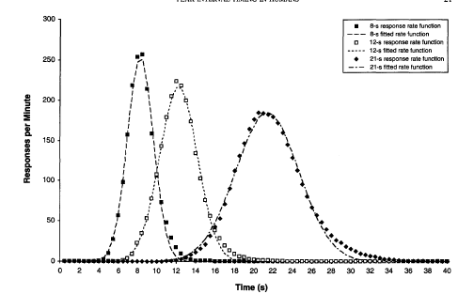
Time estimation in isolation
Peak-Interval (PI) Timing Paradigm
  - Rakitin, Gibbon, Penny, Malapani, Hinton, & Meck, 1998
  Participants attend to target intervals (8, 12, & 21 s) and reproduce them
Mean response distributions
Centered at the correct real-time criteria
Approximately symmetrical
Scalar in variability
Notes:
Participants attend to a target interval in the training trial and reproduce the same interval in the test trial
Reproduction of intervals of 8, 12, and 21s

Slide 3
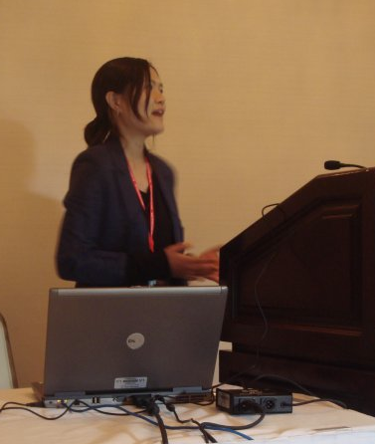

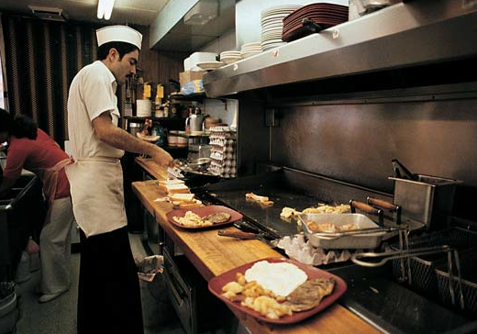
Time estimation in multitasking
Performed as a secondary task
- Involves estimating multiple time intervals
Performed under high time pressure

Slide 4
Space Fortress game
  Background
    - A computer-based video game
    - Donchin, 1989
    - Learning strategy program (DARPA)
    - Simulates real-time complex tasks
  Main Tasks
    - Navigate the ship
    - Destroy the fortress
    - Destroy the mine
Mine
Ship
Fortress

Slide 5
Time estimation in Space Fortress
M N W
Remember letters
Mine appears
Check IFF letter
Match
No match
FOE
FRIEND
IFF tapping task:
Tap J key twice with an intermediate (250-400ms) interval
Aim and fire a missile
Mine destroyed
378

Slide 6
IFF tapping task
Estimation of 250-400 ms interval
Participants receive feedback after each attempt
Participants control when to initiate and terminate the interval
Time estimation embedded in the real-time complex task
Too-early
Correct
Too-late
0
250 ms
400 ms

Slide 7
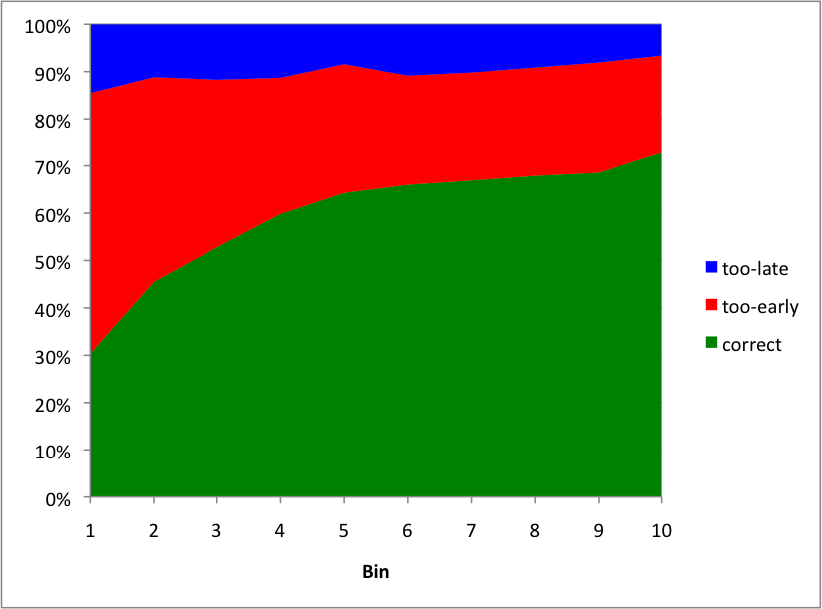

Too-early bias in the IFF tapping task
100 participants over 300 trials (30 trials/bin)

Slide 8
What factors explain the too-early bias in the IFF tapping task?
0

Slide 9
1. Distance Hypothesis
  - Participants have a limited time for the mine task
  - Participants adjust the IFF interval based on how much time is left to destroy the mine (= distance between ship and mine)
  - The less time left (= shorter distance), the stronger too-early bias
Time
Determine friend/foe
IFF tapping
Aim and fire a missile
Too-early error

Slide 10
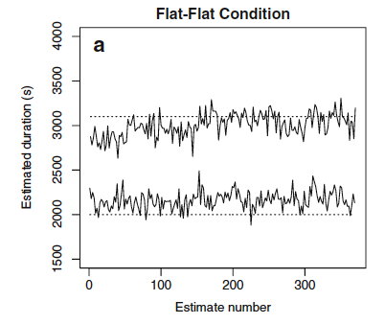
2. Contamination Hypothesis
  - Representations of different time intervals are not independent
  - Taatgen & van Rijn, 2011
  - The fortress task requires estimating a short (<250 ms) interval
Mine
Fortress

Slide 11
Experiment
Contamination Hypothesis
  Tap speed: Fast-tap (<250 ms) vs. Slow-tap (400-650 ms) alternated with intermediate-tap (250-400 ms)
Distance Hypothesis
    Distance : Short (1.8 s) vs. Long (3.7 s)
Within-participants design
 |  | Distance
 |  | Short | Long
Tap speed | Fast | Fast-Short | Fast-Long
 | Slow | Slow-Short | Slow-Long

Slide 12
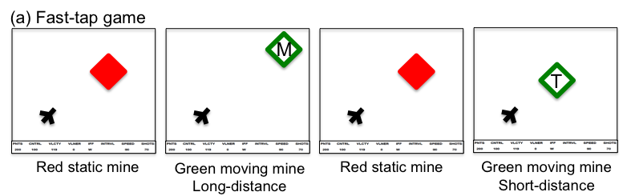
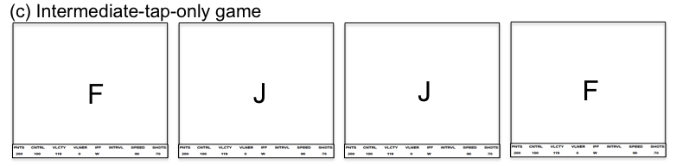
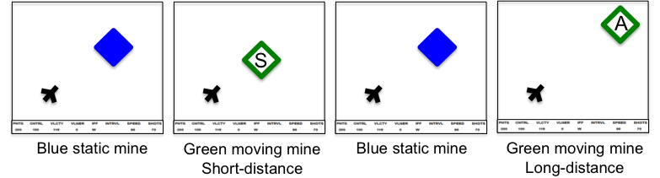
Experiment
Three game types
  Fast-tap game: alternate between fast-tap and intermediate-tap
  Slow-tap game: alternate between slow-tap and intermediate-tap
  Intermediate-tap-only game: intermediate-tap without mine task
  20 participants
  12 blocks (3 games/block)
Intermediate-tap-only game
Slow-tap game
Fast-tap game

Slide 13
Results: Fast-tap & Slow-tap games
Fast-Short
Fast-Long
Slow-Short
Slow-Long
Blocks
Blocks

Slide 14
Results: Intermediate-tap-only games
1. Participants performed well (mean accuracy: 86%)
2. The too-early bias was absent
Notes:
grand mean: 348

Slide 15
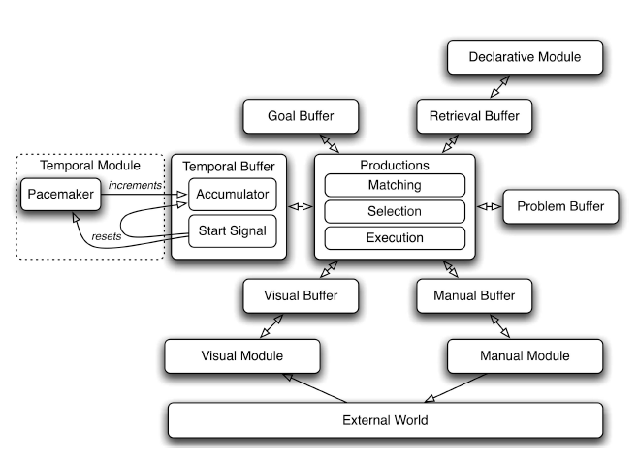
Time estimation in ACT-R
Temporal module
- Taatgen, Van Rijn, & Anderson (2007)
  Based on internal clock model (Matell & Meck, 2000)
  A pacemaker keeps incrementing pulses as time progresses
  The current pulse value is compared with a criterion to determine whether a target interval has elapsed
Taatgen, Van Rijn, & Anderson (2007)
Notes:
The center of the architecture is procedural memory (the production system), shown in the middle of the diagram. The production system has
access to all the other modules in the system through buffers, each of which can hold only a single item of information. For example,
the temporal buffer holds the current value of the accumulator, the visual buffer holds the currently attended visual stimulus, and the
retrieval buffer holds the last element retrieved from declarative memory. The basic cycle of the central production system consists
of the contents of all the buffers being matched against the rules stored in procedural memory. A single rule is then chosen on the
basis of its utility, and this rule carries out its set of actions, which it communicates to the other modules through their respective
buffers.

Slide 16
The ACT-R model of the IFF tapping task
Attend mine
Start tracking mine
Retrieve letter
Determine friend/foe
Blend pulse value
Temporal Buffer
Start Signal
Issue the first IFF tap
Accumulator
Issue the second IFF tap
Accumulated pulse value
>= Blended pulse value
Fire a missile
Evaluate the outcome

Slide 17
Contamination effect: Blending Mechanism
  - Lebiere, Gonzalez, & Martin, 2007
  - Produces a weighted aggregation of all candidate chunks in memory
Fast-tap game
Chunk Name | Tap Type | Outcome | Pulse Value
Weight
Interval-1 | Fast | Correct | 12
X .009
Interval-2 | Intermediate | Too-early | 17
X .012
Match with the request
...
X .098
Interval-7 | Intermediate | Too-early | 17
Interval-8 | Fast | Correct | 13
X .053
Interval-9 | Intermediate | Correct | 18
X .305
Interval-10 | Fast | Too-late | 14
X .103
Recency
Interval-11 | Intermediate | Correct
15.66
Blended pulse value

Slide 18
Distance effect: Emergency production rule
Default rule
The model issues the second IFF tap when the pulse value in temporal buffer reaches a criterion
Emergency rule
- If little time is left (distance < threshold), the model issues the second IFF tap ignoring the default rule
    The rule is more likely to fire in the short-distance trials
Temporal Buffer
Start Signal
Issue the first IFF tap
Accumulator
Issue the second IFF tap
When mine comes near,
issue the second IFF tap

Slide 19
Model and human in correct/too-early/too-late responses

Slide 20
Conclusion
We identified sources of asymmetric bias in millisecond time estimation embedded in a dynamic task
  Contamination from a different time interval estimation
  Time left to complete the task
ACT-R model of time estimation provides a good fit
  Blending mechanism for the contamination effect
  Emergency production rule for the distant effect
Modeling time estimation in cognitive architecture
  Accounts for time estimation performance embedded in real-time dynamic tasks
  Contributes to understanding of how temporal processing occurs in the context of human cognition

