Slide 1
SAL: A Hybrid Cognitive Architecture
Y. Vinokurov¹, C. Lebiere¹,
D. Wyatte², S. Herd², R. O’Reilly²
1. Carnegie Mellon University, 2. University of Colorado, Boulder

Slide 2
ACT-R: Overview
An established, production rule-based cognitive architecture which implements a model of declarative memory.
Created as a model of higher-level human cognition.
Highly modular: ACT-R modules expose “buffers” to the central core of the system and the buffers can connect ACT-R to the outside world.

Slide 3
ACT-R: A Schematic View

Slide 4
ACT: Memory Theory
Memory in ACT-R is stored in “chunks”; a chunk is just a data structure that contains some “slots” that are assigned values. Values can be any valid Lisp data structure including other chunks.
When a retrieval request is made, the chunk with the highest activation is retrieved. Activation is calculated according to the formula:
A = B + P + S + ε
Where B is the base level activation, P is the activation due to partial matching, S is the spreading activation (uniformly 0 in our case), and ε is the noise.

Slide 5
ACT-R’s limitations
ACT-R contains symbolic and subsymbolic components, but does not reach all the way down to the neural level.
As a consequence, ACT-R doesn’t really have “eyes” or “hands” (motor module nonwithstanding).
That makes it difficult to interact with the world in non-symbolic ways.

Slide 6
Enter Leabra
Leabra (Local, Error-driven and Associative Biologically Realistic Algorithm) is a model of neural interaction developed by O’Reilly et. al. at the University of Colorado, Boulder.
Emergent is an environment in which a Leabra model is realized. It can implement a self-contained, simulated 3D world.
In particular, a model called LVis (Leabra Vision) implements a simulation of the human visual system.

Slide 7
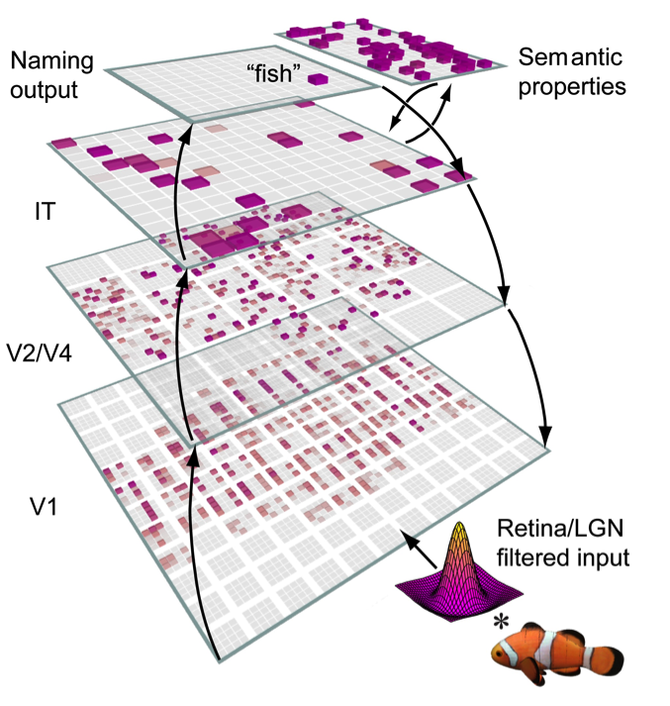
The Leabra Vision Model

Slide 8
SAL: Synthesis of ACT-R and Leabra
We combine ACT-R and Leabra by implementing an module that exposes a leabra-visual buffer to the ACT-R core.
The module handles communication with Leabra using sockets; data is obtained from Leabra and commands are issued from ACT-R.
Data taken from Leabra is transformed into chunks that are then made available in the leabra-visual buffer.
The current integration only implements an interface to the vision model, but a neural motor module is in the works.

Slide 9
SAL Applications: Metacognition
The Leabra neural network is trained to recognize 50 out of 100 object classes. The set of objects is thus partitioned into TRAIN and TEST subsets.
The ACT-R model’s declarative memory is pre-loaded with examples of both TRAIN and TEST items.
An ACT-R chunk obtained from Leabra observing an item contains parameters that measure the net activation of different layers of the network.
ACT-R’s blending mechanism is used to determine whether the observed object belongs to the TRAIN or TEST class based on a recall cued on the aforementioned activations.

Slide 10
SAL Applications: Self-supervised Object Learning
Goal: to ground symbol cognition in low-level perception.
Three pre-training regimes were used to train the Leabra neural network: full training (recognition of all object classes), half-training (recognition of only 50 object classes), and no training (network weights are random).
The set of objects presented to the model is a subset of object classes that the neural network was not trained to recognize, i.e. the TEST class.
The chunk obtained from the observation contains a vector that represents the encoding of the visual stimulus in Leabra’s simulation of the inferotemporal cortex (IT) layer.

Slide 11
Self-supervised Learning, cont.
When the integrated model observes a presented item, it tries to recall an association between the percept (i.e. the IT vector) and a label assigned to the item.
If the model fails to recall an association (which will happen initially) it generates a label (in this case, simply an integer) to associate with the percept.
The label is then used as feedback to the neural network, which adjusts its connection weights to increase the strength of association between the item and the label.
During training, network weights converge to a stable representation of the IT feature vector for each object class.
The complete model thus bootstraps from the initial feature set obtained from pre-training to learning, in a self-supervised fashion, to recognize object categories.

Slide 12
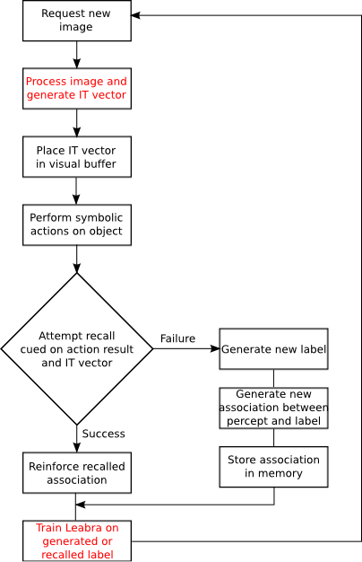
SAL Model Flow

Slide 13
Self-supervised Learning, cont.
The pre-training regime with completely random network weights does not result in any learning at all.
When the network is completely trained, the ACT-R model learns the labels almost perfectly, with the exception of shape-based confusions (globe/skull, toaster/dice).
The half-trained model is the most interesting case.

Slide 14
Fully-trained model

Slide 15
Partially-Trained Model

Slide 16
Problems with the model
The IT vector is a shape-based feature vector which does not capture orientation, size, or texture.
We need another signal that will help us distinguish between objects. Like, say, a motor signal.
We don’t have a neurally-based motor module so far, but we can do is mock up a symbolic motor module.

Slide 17
The Symbolic Motor Module
The symbolic motor module is an extension of ACT-R that “acts” on the objects. It performs some symbolic operation on a presented object and returns either success or failure.
The model remembers the results of actions just like it remembers the percept that it associates with a label.
Recalls are then cued on both action results and visual percepts.

Slide 18
Confusion matrix showing the progress of self-supervised learning that combines the IT vector information with the symbolic motor module

Slide 19
Testing the model afterwards…

Slide 20
Future Work
The next step of the SAL integration process is the creation of a neurally-based motor model in Leabra, which will interface with ACT-R via a buffer. The model is still in development.
  But the model developer, Sergio Verduzco, was just indoctrinated trained at the ACT-R summer school
We also aim to unify the metacognitive old/new recognition model with the self-supervised object learning model to improve performance.
  Use all signal sources for maximal discrimination

