Slide 1
An Updated Associative Learning Mechanism
Robert Thomson & Christian Lebiere
Carnegie Mellon University

Slide 2
Overview
What is Associative Learning (AL) and why do we need it?
History of AL implementation in ACT-R
Bayesian log-likelihood transformations
From a Bayesian to Hebbian Implementation
Recent Neural Evidence: Spike Timing Dependent Plasticity
A balanced associative learning mechanism
Hebbian and anti-Hebbian associations
Interference-driven ‘decay’
Early Results: Serial Order / Sequence Learning

Slide 3
What is Associative Learning?
Associative learning is one of two major forms of learning
The other is reinforcement, although they are not necessarily distinct ‘kinds’
It is a generalized version of classical conditioning
You mentally pair two stimuli (or a behavior and a stimulus) together
In Hebbian terms: things that fire together, wire together
ACT-R 6 currently does not have a functional associative learning mechanism implemented

Slide 4
Why have Associative Learning?
It instantiates many major phenomena such as:
Binding of episodic memories / context sensitivity
Anticipation of important outcomes
Non-symbolic spread of knowledge
Top-down perceptual grouping effects
Sequence Learning
Prediction Error (Rescorla-Wagner learning assumption)
It is flexible, stimulus-driven (and order-dependent)
Without associative learning it’s very hard to chain together non-symbolic information
E.g., Chunks with no overlapping slot values yet are found in similar contexts, such as learning unfamiliar sequences
Notes:
Brand Recognition – Plop Plop Fizz Fizz

Slide 5
History of Associative Learning in ACT-R
In ACT-R 4 (and 5), associative learning was driven by Bayesian log-odds
Association strength (s_{ji}) estimated log-likelihood of how much the presence of chunk j (the context) increases the probability that chunk i will be retrieved

Slide 6
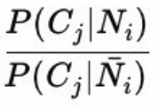
Issues with Bayesian Approach
Based on log-likelihood of recall, if two chunks (i and j) aren’t associated together, then the odds of one being recalled in the context of another is 50%
In a robust model, these chunks may have been recalled many times without being in context together
However, once these items are associated, because of the low , the odds of recalling i in the context of j ends up being much lower than if they were never associated together

Slide 7
Issues with Bayesian Approach
S_{max}
S_{ji}
Associative Strength
0
1
. . .
⁻∞

Slide 8
ACT-R 6
Spreading Activation
Set spread (S_{max}) using :mas parameter
Due to log-likelihood calculation, high fan items have their s_{ji} become inhibitory
This can lead to catastrophic failure
Mature models can’t recall high-fan items due to interference
S_{max}
Associative Strength
fan_{ji}
0
S_{ji}
. . .
⁻∞

Slide 9
From Bayesian to Hebbian
Really, the Bayesian approach of ACT-R 4 really isn’t that different from more neurally-inspired Hebbian learning
In both cases, stuff that fire together, wire together
When looking to update associative learning in ACT-R 6, we went to look at recent development in neural Hebbian-style learning
Recent work on spike-timing dependent plasticity inspired a re-imagination of INHIBITION in ACT-R associative learning
GREEN
+retrieval>
ISA action
light green
GO
retrieval
DM

Slide 10
Traditional (Neural) Hebbian Approaches
Before getting too deep into our approach, here’s some necessary background:
Synchronous
“Neurons that fire together wire together”
Change in ∆w_{ij} is a rectangular time window
Synapse association is increased if pre- and post-synaptic neurons fire within a given temporal resolution
j
t_{j}
i
t_{i}
1
∆w_{ij}
0
-∆t
∆t
0

Slide 11
Traditional Hebbian Approaches
Asynchronous
Change in ∆w_{ij} is a gaussian window
Very useful in sequence learning (Gerstner & van Hemmen, 1993)
Synapse association is increased if pre-synaptic spike arrives just before post-synaptic spike
Partially-causal firing
j
t_{j}
i
t_{i}
1
∆w_{ij}
0
-∆t
∆t
0

Slide 12
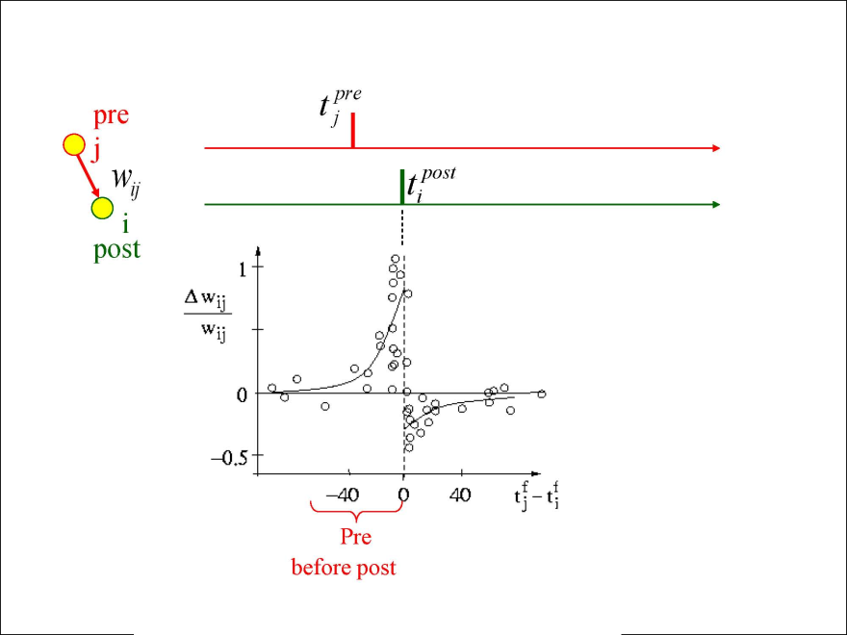
Recent Neural Advances: Spike Timing Dependent Plasticity
Spike-based formulation of Hebbian Learning
If the pre-synaptic firing occurs just before the post-synaptic firing, we get long-term potentiation
However, if the post-synaptic firing occurs just before the pre-synaptic firing, we get long-term depression
(Anti-Hebbian Learning)

Slide 13
Neural Evidence
Post-synaptic NMDA receptors use calcium channel signal that is largest when back-prop action potential arrives shortly after the synapse was active (pre-post spiking)
Triggers LTP (similar to asynchronous Hebbian learning)
You also see the same NMDA receptors trigger LTD when the back-prop action potential arrives BEFORE the pre-synaptic synapse was active (post-pre spiking)
Seen in hippocampal CA1 neurons (Wittenberg & Wang, 2006)
This is different from GABAergic inhibitory inter-neurons, which have also been extensively studied throughout cortical regions
Which I would argues is more like partial matching / similarity
Notes:
Excitation / inhibition imbalances are linked to epilepsy, schizophrenia, hypersensitivity in humans

Slide 14
From Bayesian to Hebbian - Revisited
We’ve just reviewed some interesting evidence for timing-dependent excitation AND inhibition
Why is inhibition so important?
There needs to be a balance in activation.
It’s neurally-relevant (and necessary)
The alternatives aren’t neurally-plausible
But… we’ve waited long enough, so lets proceed to the main event:

Slide 15
A Balanced Associative Learning Mechanism
Instead of pre-synaptic and post-synaptic firing, we look at:
The state of the system when a retrieval request is made
The state of the system after the chunk is placed in the buffer
Hebbian learning occurs when a request is made
Anti-Hebbian learning occurs after the retrieval
+retrieval>
ISA action
Where light
color green
DM
GO-1
retrieval
GREEN-1

Slide 16
Hebbian Learning Component
Initially based on a set spread (similar to :mas) divided evenly by the number of slots in the source chunk
This is subject to change as we implement into ACT-R
Ideally I’d like this to be driven by base level / pre-existing associative strength (variants of the Rescorla-Wagner learning rule and Hebbian delta rule)
Interference-driven ‘decay’ is another possibility
The sources are the contents of the buffers
One change we made was to have the sources be only the difference in context for reasons we’ll get into

Slide 17
Anti-Hebbian Learning Component
It’s intuitive to think that a retrieved chunk spreads activation to itself
That’s how ACT-R currently does it
However, this tends to cause the most recently-retrieved chunk to be the most likely to be retrieved again (with a similar retrieval request)
You can easily get into some pretty nasty loops where the chunk is so active you can’t retrieve any other chunk
BLI and declarative FINSTs somewhat counteract this

Slide 18
Anti-Hebbian Learning Component
Instead, we turned this assumption on its head!
A retrieved chunk inhibits itself, while spreading activation to associated chunks
By self-inhibiting the chunk you just retrieved, you can see how this could be applied to sequence learning
The retrieved chunks the spread activation to the next item in the sequence while inhibiting their own retrieval
This is a nice sub-symbolic / mechanistic re-construing of base-level inhibition
It also could be seen as a neural explanation for the production system matching a production then advancing to the next state

Slide 19
Anti-Hebbian Learning Component
The main benefit of having an inhibitory association spread is that it provides balance with the positive spread
This helps keep the strength of associations in check (i.e., from growing exponentially) for commonly retrieved chunks
Still, we haven’t spent much time saying exactly what we’re going to inhibit!

Slide 20
What do we Inhibit?
You could just inhibit the entire contents of the retrieved chunk
In pilot models of sequence learning, if the chunk contents weren’t very unique, then the model would tend to skip over chunks
The positive spread would be cancelled out by the negative spread
In the example to the right, assume each line is +1 or -1 spread
(613) 513 - 868
6 1 3
5 1 3
RECALL
6 1 3
5 1 3
8 6 8
SA1:
+3
+2
+1
IN1:
-3
-2
-1
SA2:
-1
+1
-1
SA3:
-1
-3
+3

Slide 21
Context-Driven Effects
When lists have overlapping contexts (i.e., overlapping slot-values), then there are some interesting effects:
If anti-hebbian inhibition is spread to all slots, then recall tends to skip over list elements until you get a sufficiently unique context
If anti-hebbian inhibition is only spread to unique context, then there’s a smaller fan, which facilitates sequence-based recall
The amount of negative association spread is the same, the difference is just how diluted the spread is

Slide 22
How else could we Inhibit?
Instead, we attempted to only spread and inhibit the unique context
This sharpened the association and led to better sequence recall
As you can see, you get more distinct association in sequence learning
Essentially, you (almost) always get full inhibition of previously recalled chunk
SA1:
+3
+2
+1
SA2:
-1
+1
-1
SA3:
-1
-3
+3
(613) 513 - 868
6 1 3
5 1 3
RECALL
6 1 3
5 1 3
8 6 8
S1:
+3
+2
+1
S2:
-3
+3
-3
S3:
-1
-3
+3

Slide 23
Differences from Bayesian
By moving away from log-likelihood and into a ‘pure’ hebbian learning domain, we’ve eliminated the issue of high fan items receiving negative spread
Also, this move allows us to model inhibition in a neurally-plausible manner
You can’t easily model negative likelihoods (inhibition) using a log-based notation because negative activations quickly spiral out of control
I know someone still wants to ask: why do we NEED to model inhibition?

Slide 24
Issues with Traditional Approaches
Traditional Hebbian learning only posited a mechanism to strengthen associations, leading modelers to deal with very high associative activations in a ‘mature’ models
You need to balance activations!
Three(ish) general balancing acts:
Squash: Fit ‘raw’ values to logistic/sigmoid type distribution
Decay: Have activations decay over time
Do Both

Slide 25
Squashing Association Strength
Most traditional Hebbian-style learning implementations aren’t very neurally plausible in that our brains don’t handle stronger and stronger signals as we learn
Many cell assemblies require some form of lateral inhibition to specialize
Squashing association strength, generally to a [0 to 1] or [-1 to 1] range, also isn’t very neurally plausible
Let’s look an at example:

Slide 26
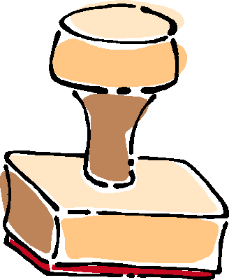
Squashing Associations

Slide 27
Squashing Association Strength
It looks silly as an animation, but it’s what a lot of implementations do
Instead of squashing to a non-linear distribution, we should be trying to find a balance where associative learning is more-or-less zero sum
That’s what our mechanism attempts to do, by balancing excitatory and inhibitory associations
The goal is to specialize chunk associations by serializing/sequencing recall
Degree of association gain will be based on prior associative strength and/or base-level of involved chunks

Slide 28
Interference-Driven Decay
Another alternative to squashing is interference-driven ‘decay’
‘Decay’ based on interference due to list length
As the number of items to recall in a similar context grows, the amount of activation spread is reduced
We also have a variant based on list length and recency
Results fit an exponential decay function (on next slide)
Further work will find the balance between interference-driven and temporal-based decay
I prefer an expectancy-driven associative system where highly associated chunks won’t get a big boost
This may be modeled similar to how base-level is calculated

Slide 29
Interference-Driven Decay

Slide 30
An Example: Serial Order Effects
Recall a list of 8 chunks of 3 elements in sequence
Assume spread of 3
No full-chunk repetition
No within-chunk confusion
Chunk Associations
----- ------------
(8 0 6) (8 . -1.0) (0 . -1.0) (6 . -1.0) (4 . 1.0) (9 . 1.0) (1 . 1.0)
(4 9 1) (4 . -1.0) (9 . -1.0) (1 . -1.0) (6 . 1.0) (7 . 1.0) (5 . 1.0)
(6 7 5) (6 . -1.5) (7 . -1.5) (0 . 1.0) (5 . 2.0)
(5 0 5) (0 . -1.0) (5 . -2.0) (3 . 1.0) (2 . 1.0) (4 . 1.0)
(3 2 4) (2 . -1.5) (4 . -1.5) (6 . 1.0) (9 . 1.0) (3 . 1.0)
(6 9 3) (6 . -3.0) (3 . 1.0) (9 . 1.0) (7 . 1.0)
(3 9 7) (3 . -1.0) (9 . -1.0) (7 . -1.0) (2 . 1.0) (4 . 1.0) (6 . 1.0)
(2 4 6) (2 . -1.0) (4 . -1.0) (6 . -1.0)
Notes:
No time to Review

Slide 31
Serial Order: Confusion Matrix
We get serial order ‘for free’ by context-driven asynchronous spread of activation
Emergent property of model, wasn’t expected
Recall Position
1 2 3 4 5 6 7 8 _
0.865 0.025 0.015 0.015 0.005 0.020 0.030 0.025
0.000 0.780 0.030 0.050 0.045 0.025 0.035 0.035
0.025 0.005 0.710 0.045 0.050 0.070 0.050 0.045
0.025 0.055 0.010 0.645 0.045 0.065 0.085 0.070
0.015 0.040 0.080 0.030 0.585 0.065 0.090 0.095
0.025 0.045 0.080 0.090 0.045 0.540 0.070 0.105
0.020 0.040 0.045 0.090 0.120 0.045 0.545 0.095
0.020 0.055 0.050 0.055 0.085 0.135 0.075 0.525
Chunk Order

Slide 32
Positional Confusion
In the ACT-R 4 model of list memory, position was explicitly encoded and similarities were explicitly set between positions (set-similarities pos-3 pos-4 .7)
Interestingly, with our model of associative learning, you get some positional confusion ‘for free’ out of the asynchronous nature of the learning
You don’t get a fully-developed gaussian dropoff, but things like rehearsal and base-level decay aren’t modeled yet

Slide 33
Positional Confusion – 5 Elements

Slide 34
Future Plans / Open Questions
How will we merge associations?
Which buffers will be sources of association and which will use associative learning?
Optimize processing costs?
Use associative learning to replicate classical-conditioning experiments
Extend to episodic-driven recall
Use association to drive analogical reasoning

