Slide 1
Objectives
Current state of CA research.
Current trends in CA research.
Roadmap, goals etc.
Panelists – Mike Byrne, Glenn Gunzelmann, Clayton Lewis, Dario Salvucci, Niels Taatgen.
5 minutes (single slide) from each presenter.
Discussion.

Slide 2
<Qualitative Assessment of the Current State of CAs>

Slide 3
Cognition pretty good, perception/action/spatial less so; still too hard to learn/use
Modularization
Less modifications to core; new functions handled by additional modules
Triumph of neuroscience
Brain pictures > behavior
Robotics
Some counterbalance to neuroscience
For CAs to impact Human Factors/HCI…
Connection to external worlds must be easier
Whence SegMan?
Pedagogy and system UI continue to improve, but long way to go
More like CogTool!

Slide 4
As a community, we are addressing “…questions of a depth… that they can hold you for an entire life, and you’re then just a little ways into them.” (Newell, 1991)
Progress is slow (& slowing)
And 1000 flowers are dying!
Using architectures to play 20 questions with nature
c.f., Anderson, 2010; Salvucci, 2011
Successful applications are stale
Lack a unified vision as a scientific community
Scope (Basic Research)
Mechanisms, not models
“Peripheral assumptions”**
How does the core evolve?
Transition (Applied Research)
Apps don’t have to be killer
Pasteur’s Quadrant
Sweet spot for architectures
**Cooper (2007)
Notes:
Dying flowers:
-Learning from instruction
-EMMA
-Fatigue(?)
-Spatial(?)
-Mike’s or Neils’ visual mods
Neisser (1963)
--Emotions
--Development
--Multitude of goals
Newell (1973)
--Complete models
--Complex tasks
--Multiple tasks

Slide 5
Dazzling range of really useful applications, impressive linkages to brain structure
Many fundamental issues not (yet) addressed
--------- Issues
Biological heterogeneity
Garcia & Koelling (1966)
Multiple visual systems
Goodale and Milner
E.O. Wilson us-them behaviors
Linkage between the biological and the arbitrary
The Colorado Avalanche problem
Essential multiple purposes disclaimer
Elegance must defer to evidence
Crick’s comma free code
But we do not have to abandon hope for unifying structures
The genetic code is at the same time arbitrary and strongly conserved across time and species
A code with interpretive machinery that actually makes something is not easily achieved
A code for behavior with these properties might be found by studying the specifics of motor control
This could extend into the domain of abstractions: Mac Lane, Lakoff and Nuñez

Slide 6
REFERENCES
Crick, F. (1990) What Mad Pursuit: A Personal View of Scientific Discovery. New York: Basic Books.
Garcia, J., & Koelling, R. A. (1966). Relation of cue to consequence in aversion learning. Psychonomic Science, 4, 123-124.
Goodale, M. and Milner, D. (2004) Sight Unseen: An Exploration of Conscious and Unconscious Vision. Oxford: Oxford University Press.
Lakoff, G. and Nunez, R. (2000) Where mathematics comes from: how the embodied mind brings mathematics into being. New York: Basic Books.
Mac Lane, S. (1981) Mathematical models: A sketch for the philosophy of mathematics. American Mathematical Monthly, 88(7), 462-472.
Nowak, M.A., Tarnita, C.E., and Wilson, E.O. (2010) The evolution of eusociality. Nature, 466, 1057-1062.
Wilson, E.O. (2012) The Social Conquest of Earth. New York: Norton.
(recommend podcast interview at http://www.nypl.org/audiovideo/e-o-wilson-social-conquest-earth)

Slide 7
Individual Tasks (not coverage, but benefit left to be gained)
Generality/Reuse/Variability (extending across multiple (many!) tasks)
Architecture as fitting quantitative empirical data (the ACT-R way: “no magic”)
Architecture as demonstrating functionality (the Soar way?)
Is there tension between them?
Are there limitations to the ACT-R data-fitting approach?
Is data fitting besides the point?
(Thanks to Richard Young!)
Goal: Finding middle ground?
i.e., showing functionality without producing quantitative fits
But who “consumes” this? Cog Sci audience? AI audience?
Does model reuse & generality really matter?
What does it say about cognition?
Maybe we just need (another?) killer app…

Slide 8
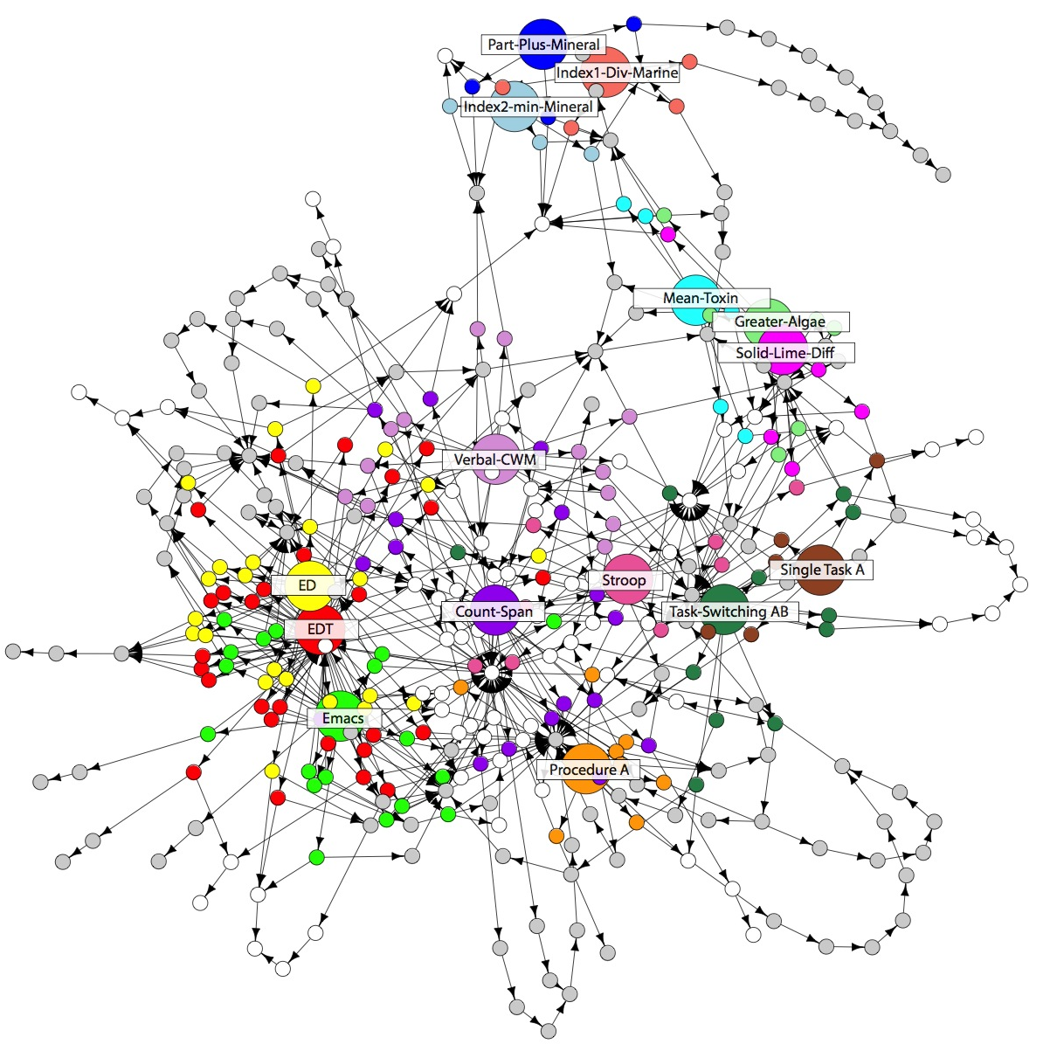
Problem: Current cognitive architectures can only provide us with what is innate. This does not provide enough constraint on models.
Current
Task 1
Task 2
Task 3
Task 4
Task 5
Task 1
Task 2
Task 3
Task 4
Task 5
General
Skills
General
Knowledge
Cognitive Architecture
Cognitive Architecture

